Slide 1
Form Processing in PHP

Slide 2
Forms
Forms are special components which allow your site visitors to supply various information on the HTML page.
We have previously talked about creating HTML forms.
Forms typically include some input elements to gather information. We have also talked about client-side form validation using javascript.
This time we are going to talk about processing forms at server side using PHP.

Slide 3
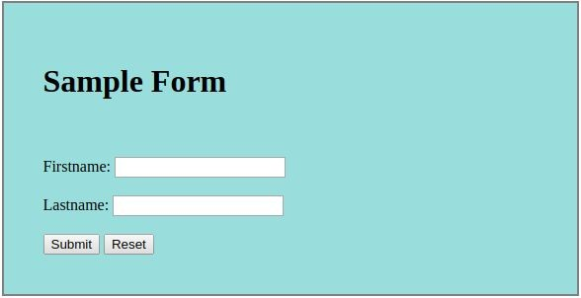
Forms
index.html
<form name="myForm" id="myForm">
<br><br>
<span id="firstname">Firstname: </span>
<input type="text" name="firstname"><br><br>
<span id="lastname">Lastname: </span>
<input type="text" name="lastname"><br><br>
<input type="submit" name="submitBtn">
<input type="reset" name="resetBtn">
</form>

Slide 4
Forms
HTML forms can have many attributes. Two of the most important attributes for HTML forms that we haven't talked about so far are:
action: The action parameter tells the browser what script/site must be called when the visitor presses the submit button.
method: The method parameter tells the browser by which method to send the user submitted data to the web-server. The parameter values are either POST or GET.

Slide 5
Forms GET vs. POST
Two ways the browser can send parameters to the web server
GET - Parameters are placed on the URL which is retrieved.
POST - The URL is retrieved and parameters are appended to the request in the HTTP connection.

Slide 6
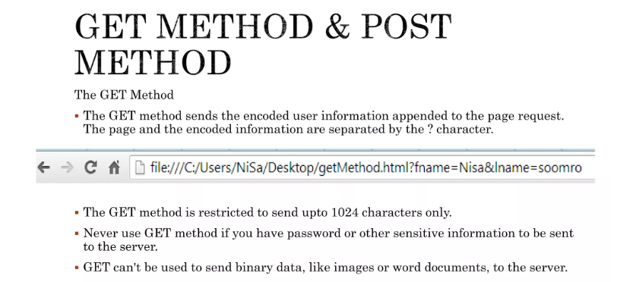

Slide 7
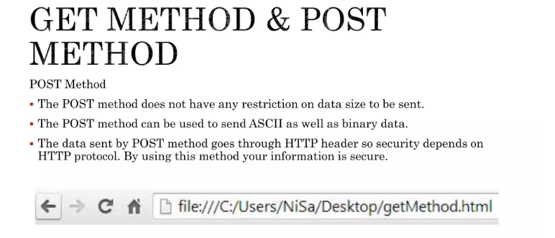

Slide 8
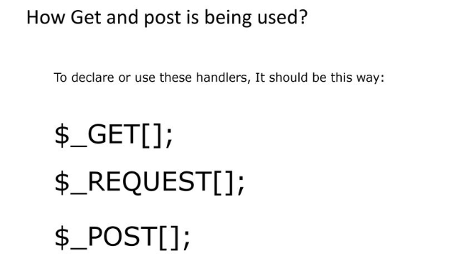

Slide 9
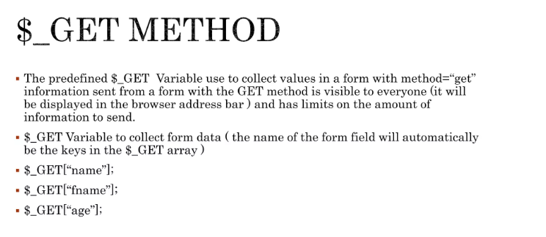

Slide 10
Forms
index.html
<form name="myForm" id="myForm" action="process.php" method="GET">
<br><br>
<span id="firstname">Firstname: </span>
<input type="text" name="firstname"><br><br>
<span id="lastname">Lastname: </span>
<input type="text" name="lastname"><br><br>
<input type="submit" name="submitBtn">
<input type="reset" name="resetBtn">
</form>
We are telling the browser to send form data to "process.php" file by using "get" method, upon form submission.

Slide 11
Accessing Form Data in PHP using GET
when the user enters information in the form and clicks the submit button, the form data will be sent to the PHP file specified by the action attribute
When GET method is used, form data will be saved in an array called $_GET
$_GET is an associative array, with the form field names used as the array keys and form field values stored as values
This array element holds the value
$_GET['firstname']
for firstname field in the form
$_GET['lastname']
This array element holds the value for lastname field in the form

Slide 12
Using Form Data in PHP
Once you know how to access form data in PHP, you can use it just like any other variable
In this example, we write a PHP function that welcomes the user to our web site.
process.php
<?php
function welcome($fname, $lname)
{
echo '<h1>Welcome ' . $fname . ' ' . $lname . '!</h1>';
}
welcome($_GET['firstname'], $_GET['lastname'])
?>

Slide 13
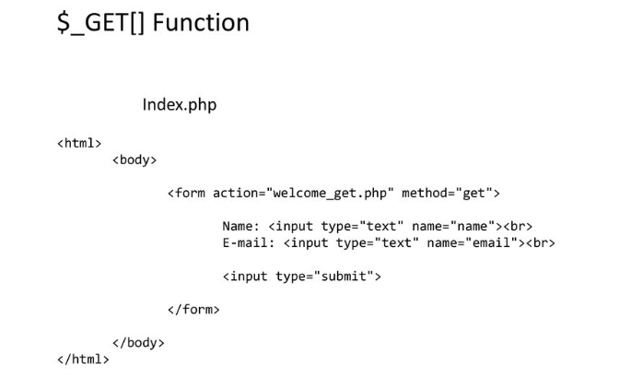
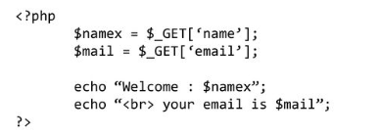

Slide 14
Example - $_GET
<html>
<body>
<form action="newpage.php" method="post">
Name: <input type="text" name="name">
Age: <input type="text" name="age">
<input type="submit">
</form>
</body>
</html>

Slide 15
Example - $_GET continued
<body>
Welcome <?php echo $_GET["name"];?>.<br/>
You are <?php echo $_GET["age"];?> years old
</body>

Slide 16
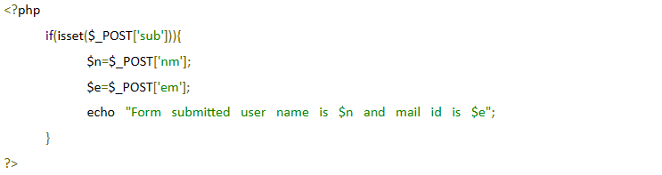
Isset function
The isset() function checks whether a variable is set, which means that it has to be declared and is not null.
This function returns true if the variable exists and is not null, otherwise it returns false.
USE $_GET HERE

Slide 17
method="POST"
The built-in $_POST array is used to collect values from a form sent with
method="post".
Information sent from a form with the POST method is invisible to others and has no limits on the amount of information to send.

Slide 18
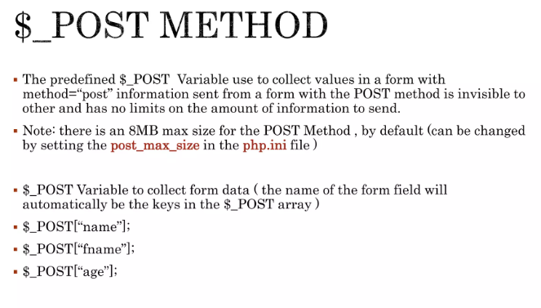

Slide 19
Form with method="POST"
index3.html
<form name="myForm" id="myForm" action="process2.php" method="POST">
<br><br>
<span id="firstname">Firstname: </span>
<input type="text" name="firstname"><br><br>
<span id="lastname">Lastname: </span>
<input type="text" name="lastname"><br><br>
<input type="submit" name="submitBtn">
<input type="reset" name="resetBtn">
</form>
We are telling the browser to send form data to "process.php" file by using "post" method, upon form submission.

Slide 20
Accessing Form Data in PHP using POST
when the user enters information in the form and clicks the submit button, the form data will be sent to the PHP file specified by the action attribute
When POST method is used, form data will be saved in an array called $_POST
$_POST is an associative array, with the form field names used as the array keys and form field values stored as values
This array element holds the value
$_POST['firstname']
for firstname field in the form
$_POST['lastname']
This array element holds the value for lastname field in the form

Slide 21
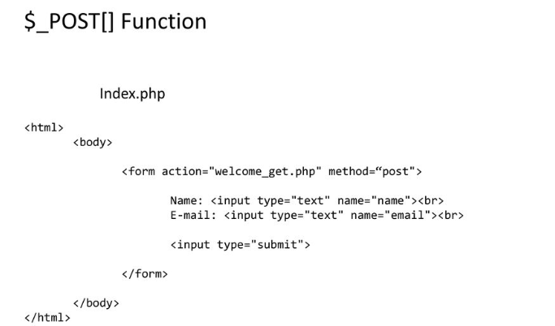
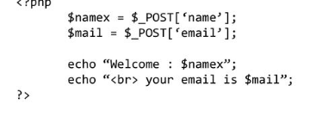

Slide 22
Using Form Data in PHP
Once you know how to access "POST" form data in PHP, you can use it just like any other variable
In this example, we write a PHP function that welcomes the user to our web site.
process2.php
<?php
function welcome($fname, $lname)
{
echo '<h1>Welcome ' . $fname . ' ' . $lname . '!</h1>';
}
welcome($_POST['firstname'], $_POST['lastname'])
?>

Slide 23
Example - $_POST continued
<html>
<head>
<title>Grab form values</title>
</head>
<body>
Welcome <?php echo $_POST["name"];?>.<br/>
You are <?php echo $_POST["age"];?> years old
</body>
</html>

Slide 24
Isset function
The isset() function checks whether a variable is set, which means that it has to be declared and is not null.
This function returns true if the variable exists and is not null, otherwise it returns false.

